Slide 1
Healthcare NLP
State-of-the-art Clinical Information Extraction

Slide 2
Nlp in healthcare
Scalable/parallel training
Why?
OCR/Negation
About…
Not about…
HOW?
productionizing nlp
Challenges
Evaluation/validation
Notes:
© Copyright Showeet.com

Slide 3

“AI can be fetishized. It’s painful to watch people misuse it. Revisiting my analogy of applied machine learning as innovating in the kitchen… if you’re innovating with recipes, don’t reinvent the wheel. Those microwaves exist already. I can’t help but imagine them refusing to use microwaves until they built one themselves. Build that Winning Recipe, Chef. Not the Microwave… ”
Why businesses fail at machine learning?
By Cassie kozyrkov
Google chief Decision Scientist
Credits photo: toddpoirier (from Pixabay - CC0 Public Domain - Free for commercial use - No attribution required)
Notes:
© Copyright Showeet.com – Free PowerPoint Templates

Slide 4




NLP
Industrial-strength NLP Frameworks
Transformer models and Transfer Learning
Word Embeddings
(Word2Vec)
Neural Language Model
Notes:
© Copyright Showeet.com – Creative & Free PowerPoint and Google Slides Templates

Slide 5
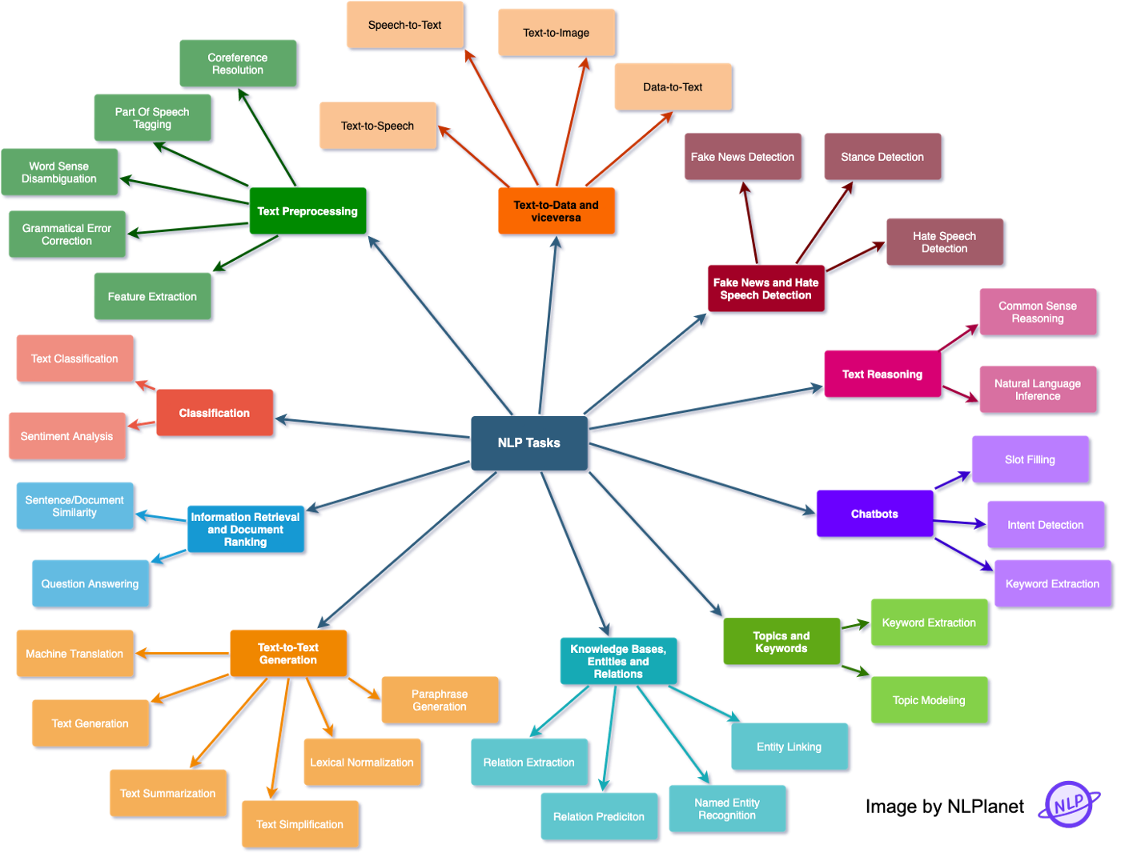

Slide 6


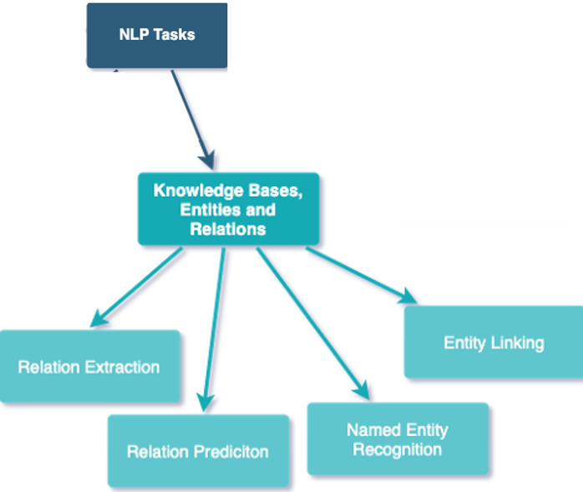

Slide 7

Named Entity Recognition (NER)
Technique that automatically identifies named entities in a text and classifies them into predefined categories
Technique disambiguating textual mentions to different meanings

Slide 8
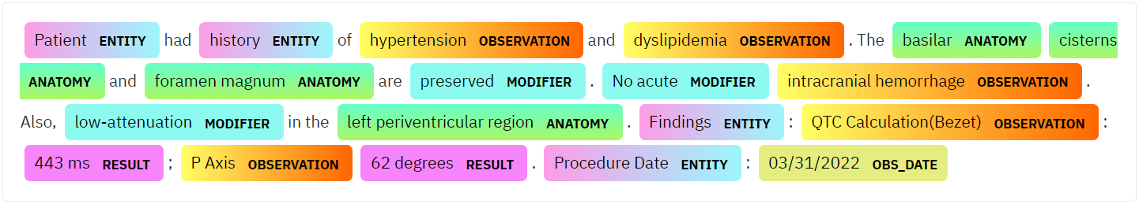
Named Entity Recognition (NER)
Patient had history of hypertension and dyslipidemia. The basilar cisterns and foramen magnum are preserved. No acute intracranial hemorrhage. Also, low-attenuation in the left periventricular region. Findings: QTC Calculation(Bezet): 443 ms; P Axis 62 degrees. Procedure Date: 03/31/2022

Slide 9
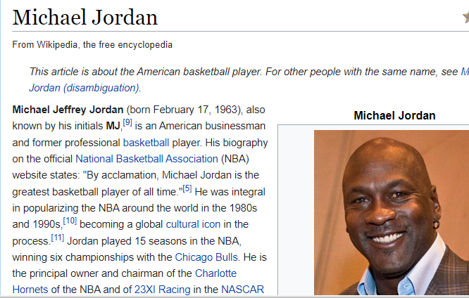
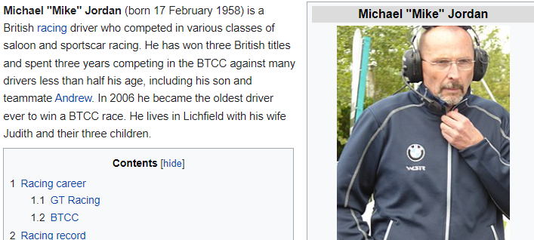
Named Entity Linking (NEL)
But how we can ground this information into the “real world”, or it is approximation - knowledge base ?!
Which Jordon is in the text?

Slide 10
Named Entity Linking (NEL)
Technique disambiguating textual mentions (tagged as named entities) to different unique identifiers in a knowledge base.
There will be more than one entity for the same mention string in KB– “Michael Jordon (basketball player)” vs “Michael Jordon (racing driver)”
The mapping between a mention in a context and KB entity is required to retrieve the correct mention
Entity Linking is the process of matching a mention, e.g. “Michael Jordon” in a textual context to a KB entity (e.g. “basketball player” or “racing driver”) fitting the context

Slide 11
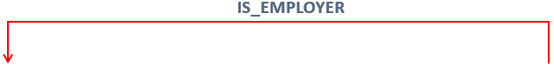
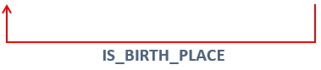
Relation Extraction (RelEx)
Technique of extracting semantic relationships from text, which usually occur between two or more entities.
Extract the relations between entities

Slide 12
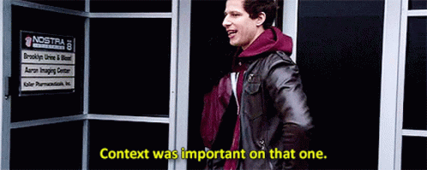
Context is Everything!

Slide 13

Why?
Significance of NER in Healthcare…

Slide 14

Healthcare data is an ever-growing resource stored in unstructured text form
80
%
Notes:
© Copyright Showeet.com – Free PowerPoint Templates

Slide 15

1
Free text and Quality
Bigger and more Complex
2
01
there is little to no standardization of the content, format, or quality; Thus, we cannot yet make effective decisions in healthcare through analytics because of the form our data is in
Clinical note record is approximately 150 times as large than structured data stored in DB. This scale introduces data transfer and storage complexities
02
3
Big Volume
Rule-based limitation
4
04
EHR data as it is today and given the amount of time and effort it would need for humans to read and reformat it, is unusable.
key-word extraction not compute efficient, less scalable, not capable to extract meaning from text and infer context
Notes:
© Copyright Showeet.com – Creative & Free PowerPoint Templates

Slide 16





Fee-for-service healthcare value-based care model
Improve EHR Data Usability
Enable Predictive Analytics
Efficient data storing thanks to transformation of text into structured form. Effective data sharing since masking PHI
Once NLP converts the text to structured data, it can be used to classify patients, extract insights, and summarize information and develop predictive ML models, Question Answering, Inference
Accelerate Clinical Trial Matching
Term Normalization/Mapping
NLP can automatically identify eligible candidates for clinical trials and make it a seamless procedure.
Enables effectively and precisely mapping extracted terms to medical terminology codes such as SNOMED, ICD-10, RxNorm, LOINC
Notes:
© Copyright Showeet.com – Creative & Free PowerPoint Templates

Slide 17
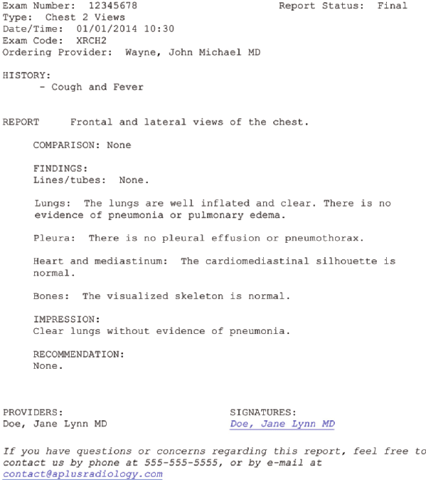
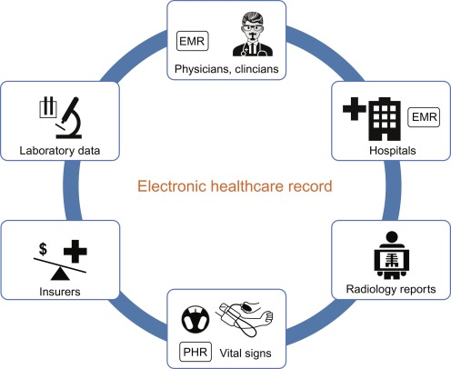
EHR Reporting Template
OTHER IDENTIFICATIONS
BODY
IMPRESSION

Slide 18

How?
Methodology and Framework…

Slide 19

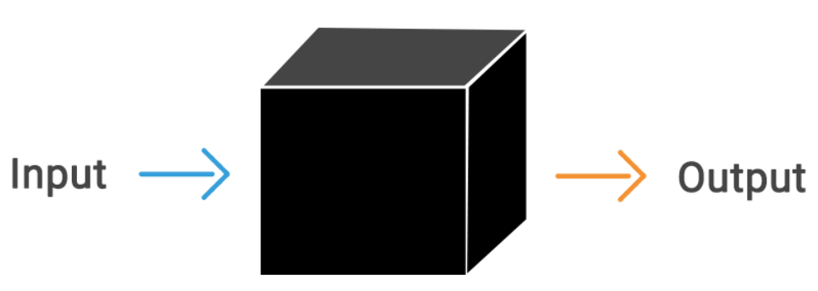

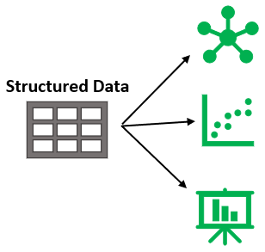

From .…. To

Slide 20
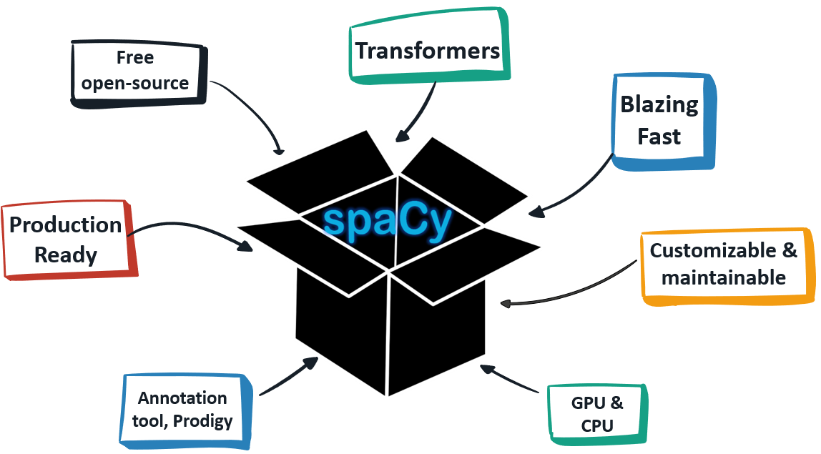
From .…. To

Slide 21
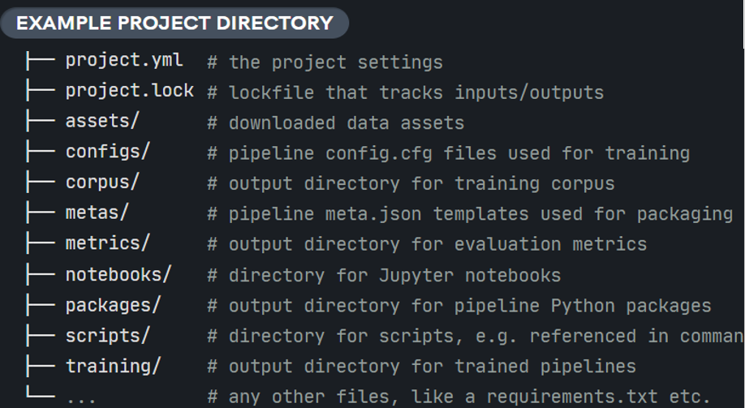
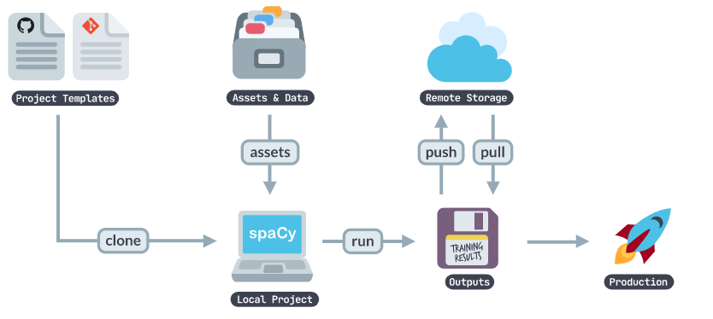
Spacy Projects

Slide 22
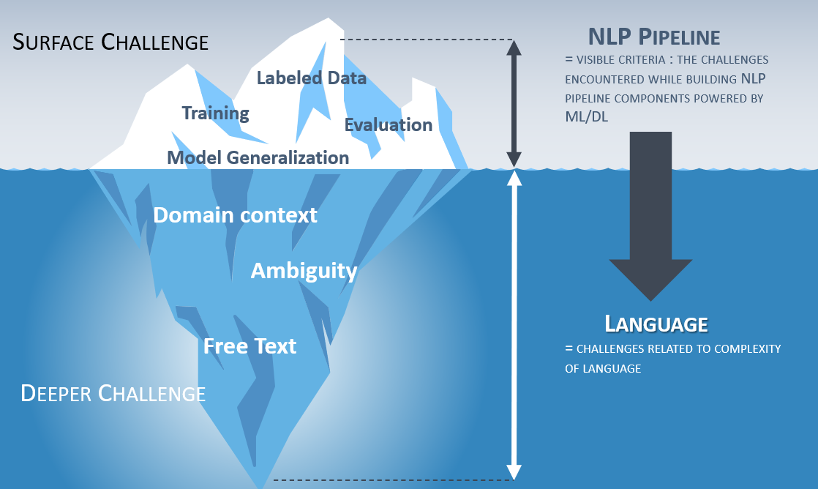
The Iceberg Analogy of NLP Challenges

Slide 23
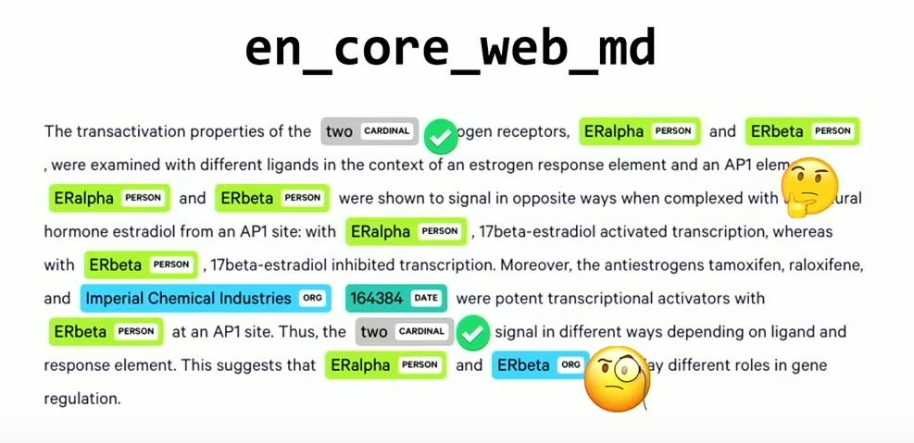
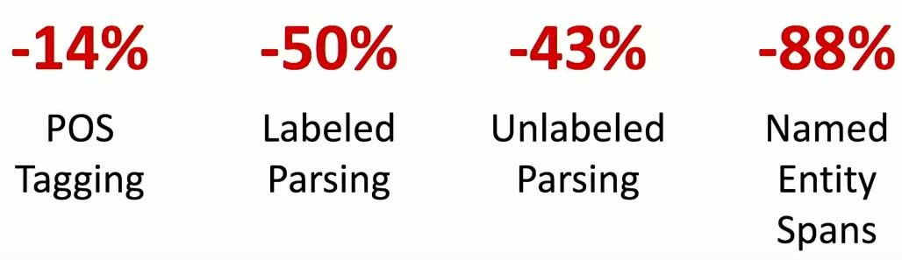
Domain Matters!
Source: Spacy IRL, accessed at https://www.youtube.com/watch?v=2_HSKDALwuw

Slide 24

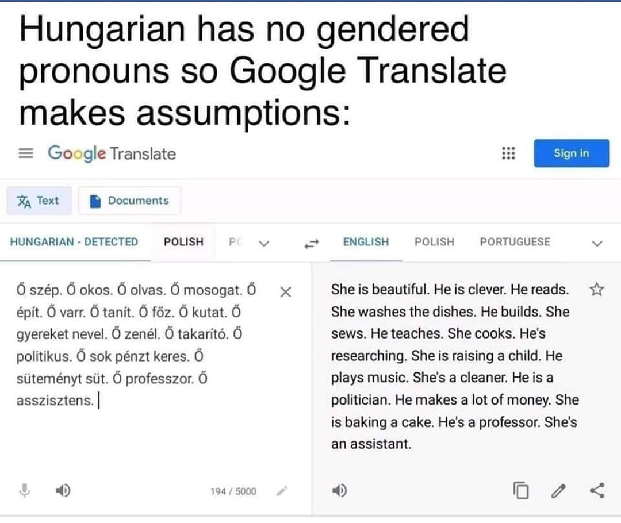
Bias and Ambiguity

Slide 25
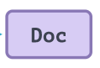


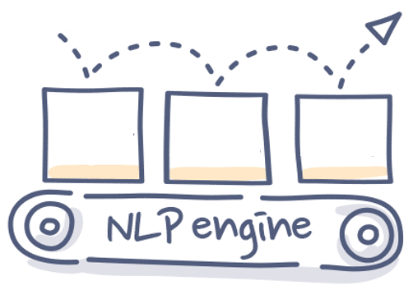
From .…. To

Slide 26
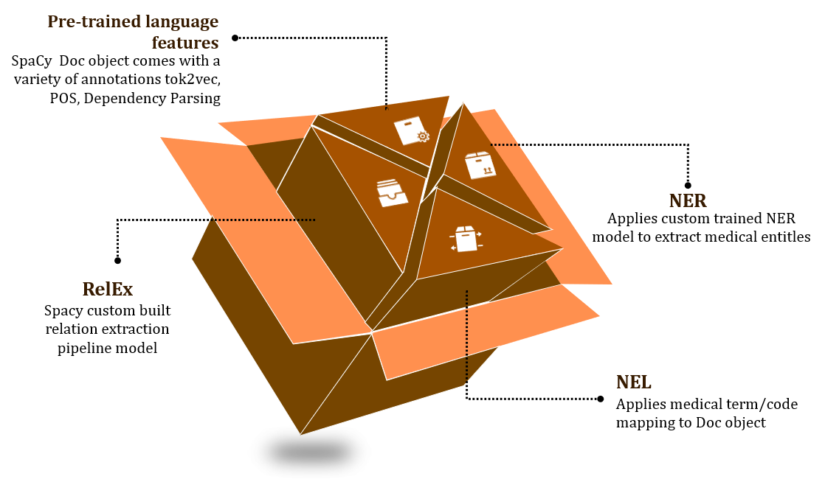

Slide 27
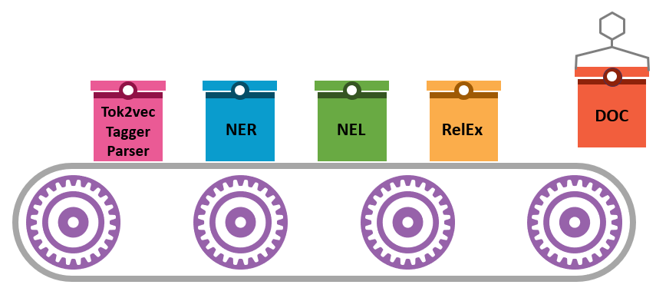
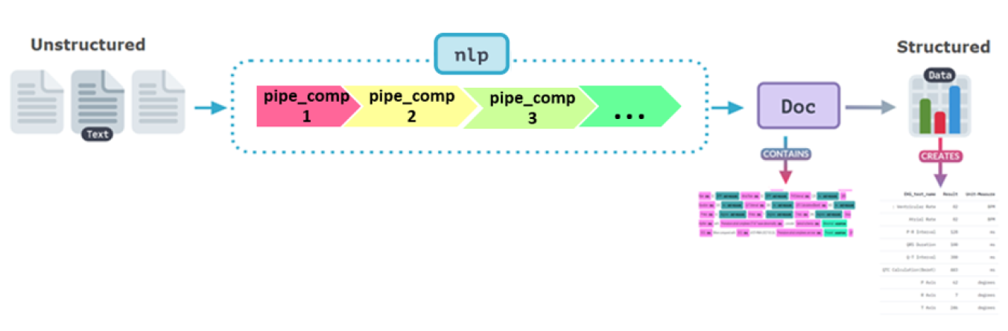
Spacy Pipeline Components

Slide 28
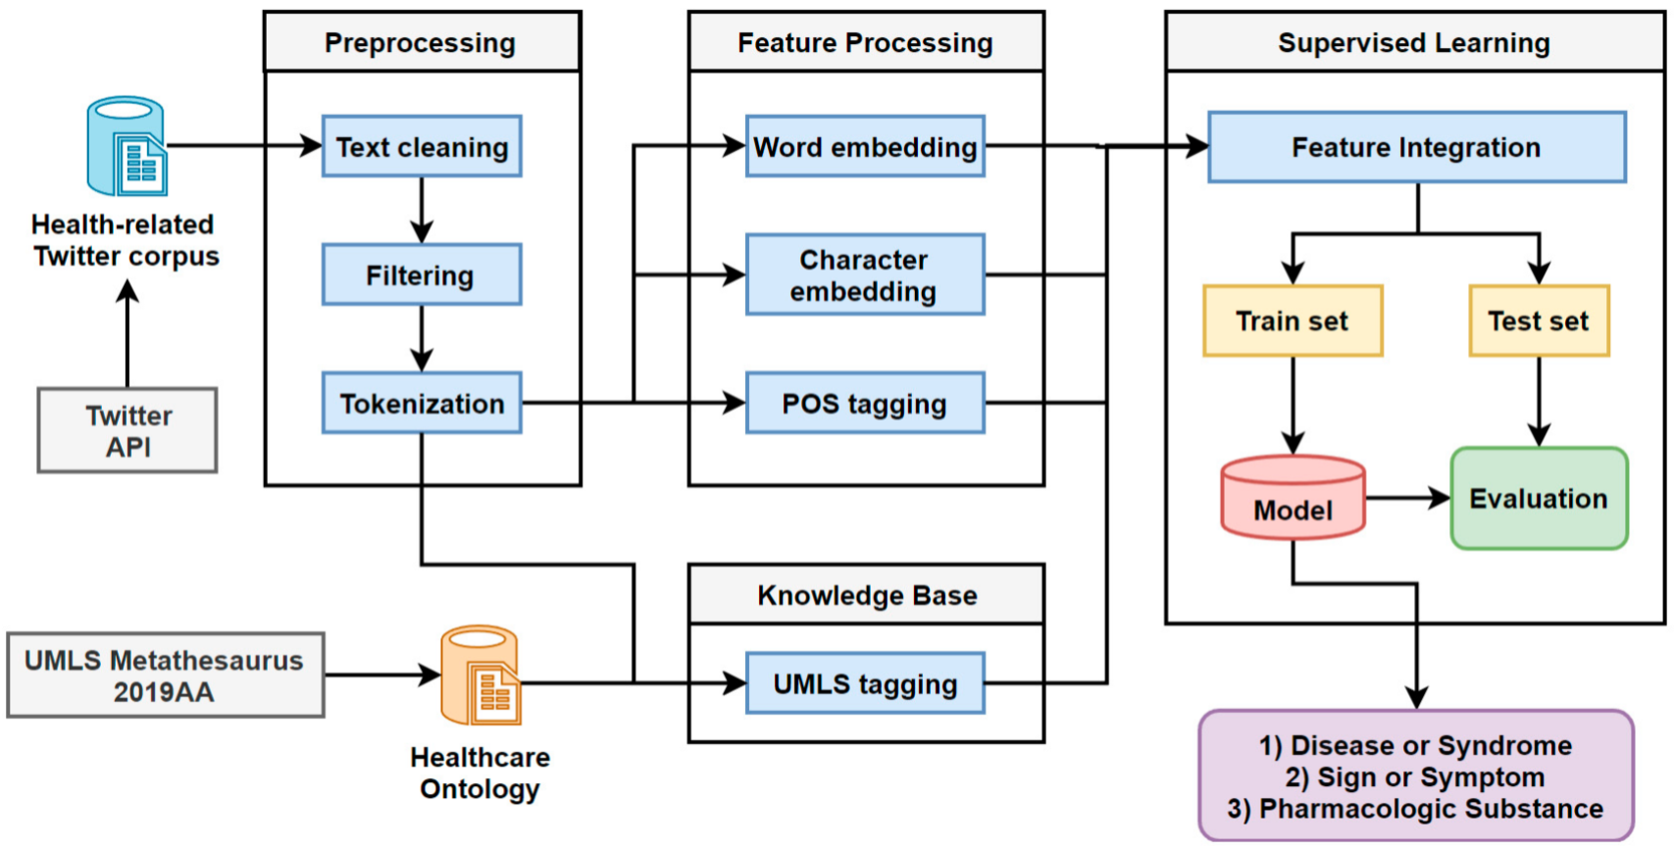




Slide 29
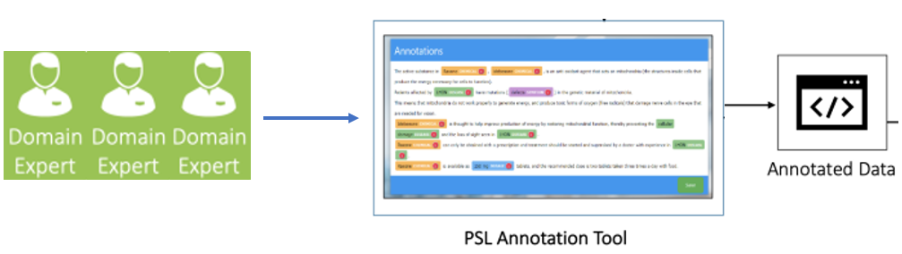
Gold Parse Annotations

Slide 30
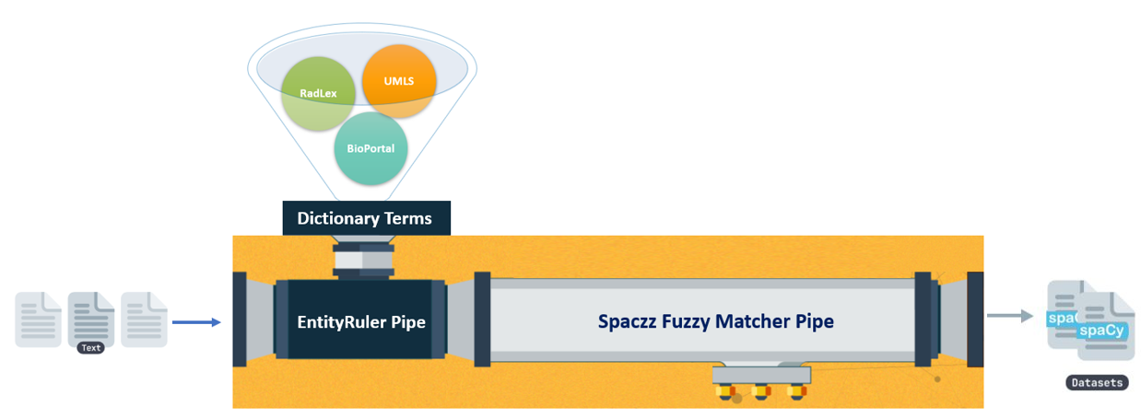
Silver Annotations
EntityRuler Pipe

Slide 31

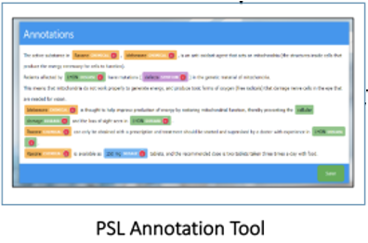
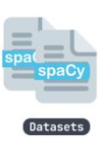
Mixed Annotation Approach

Slide 32
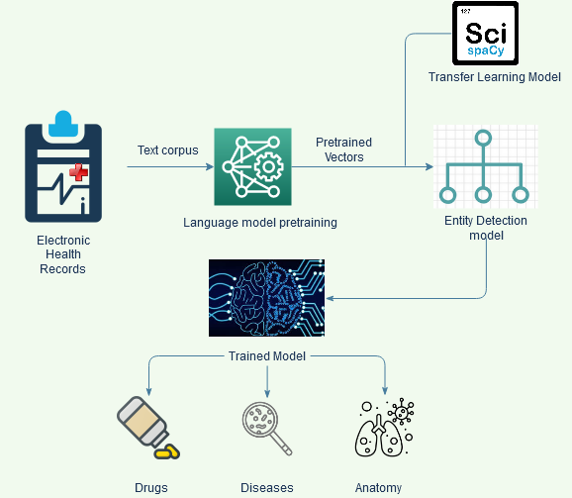

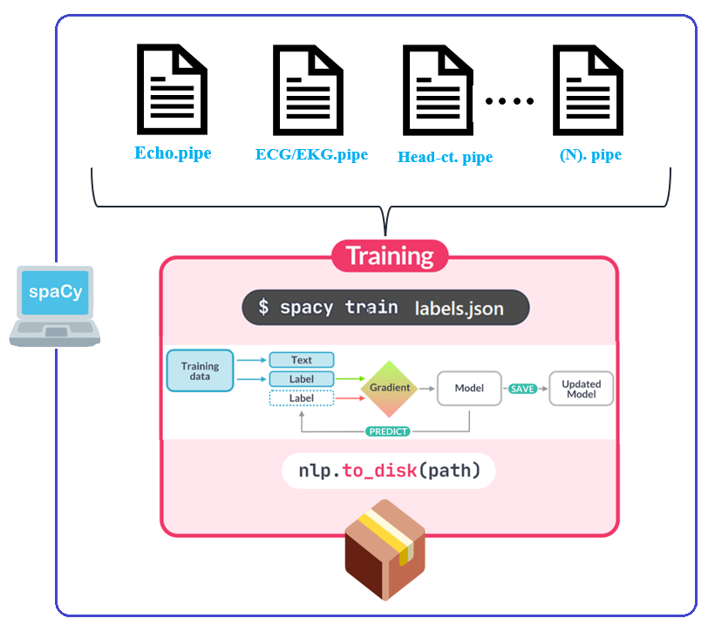

NER Training

Slide 33
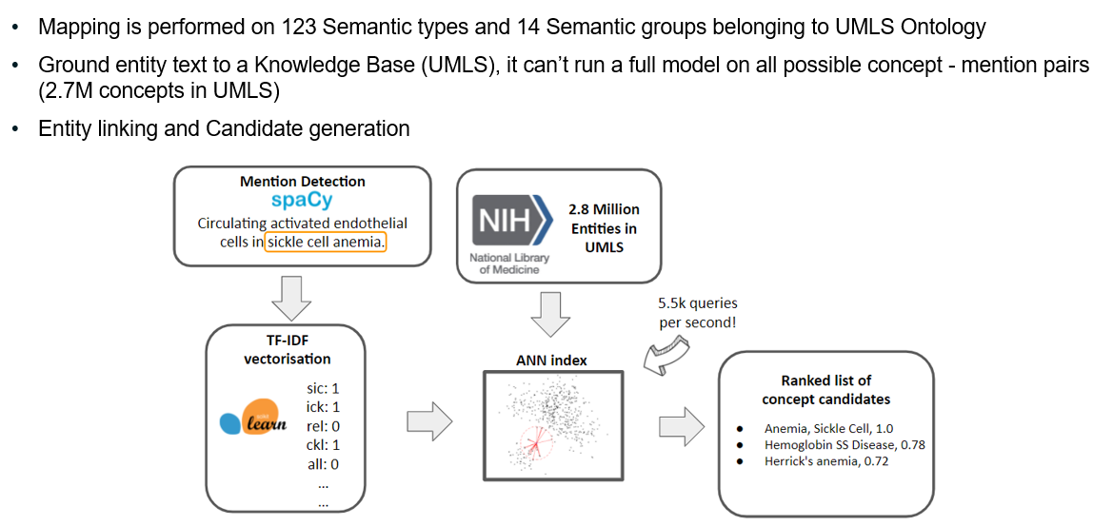
Entity Linking

Slide 34
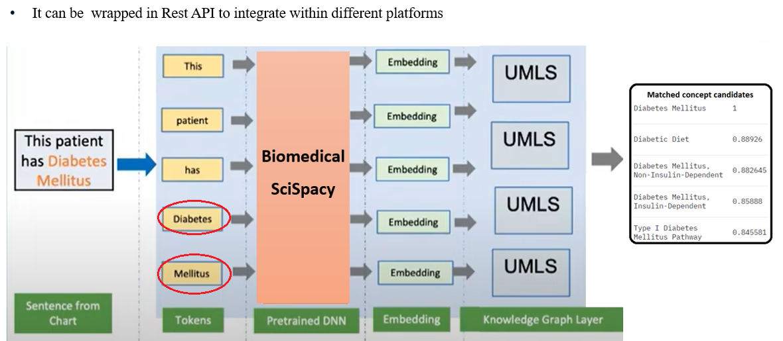

Entity Linking

Slide 35
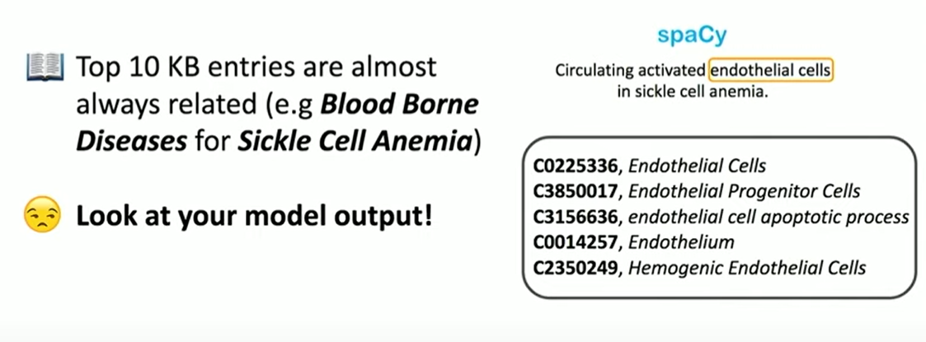
Entity Linking

Slide 36
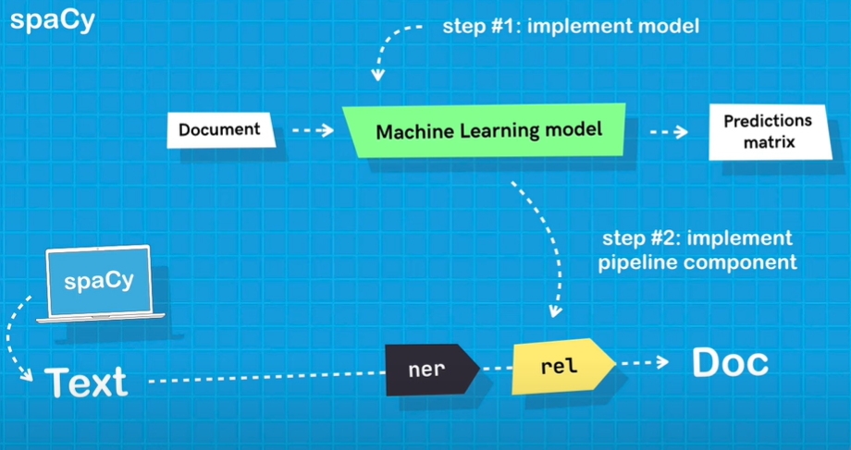
RelEX

Slide 37
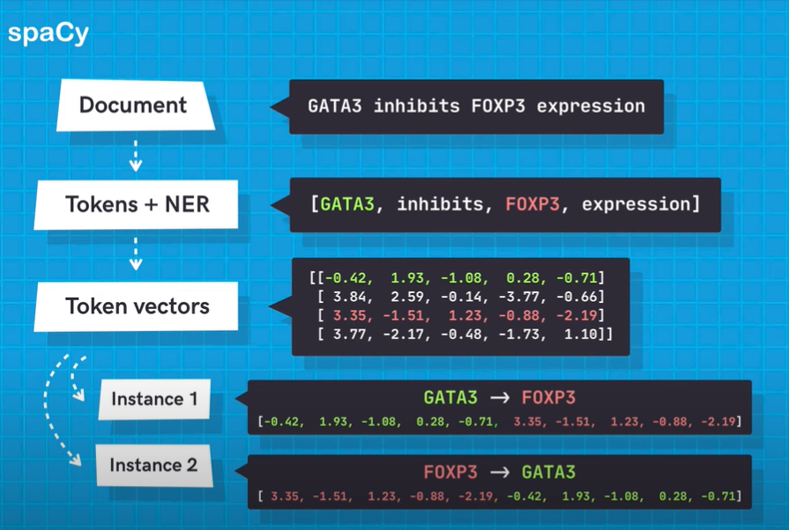
RelEx

Slide 38
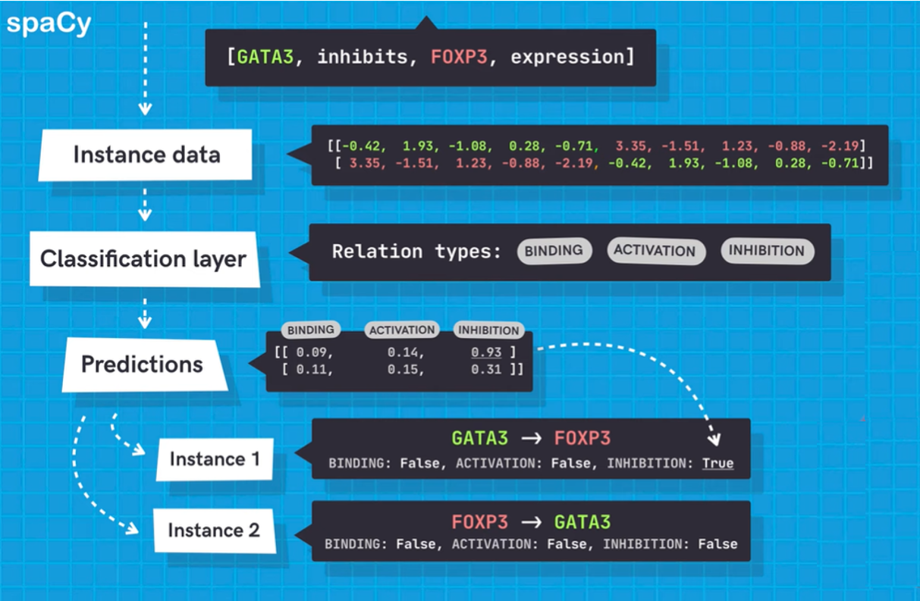
RelEx

Slide 39
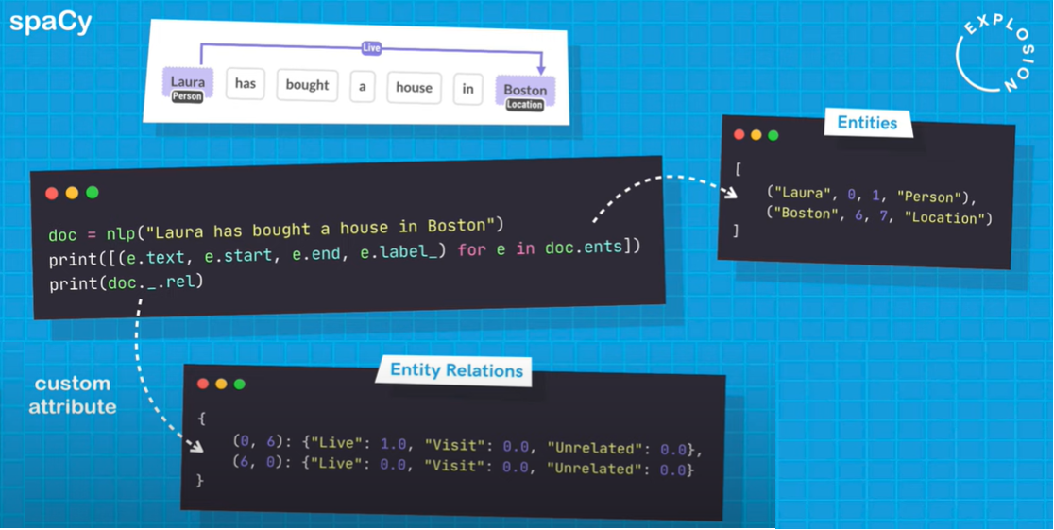
RelEx

Slide 40
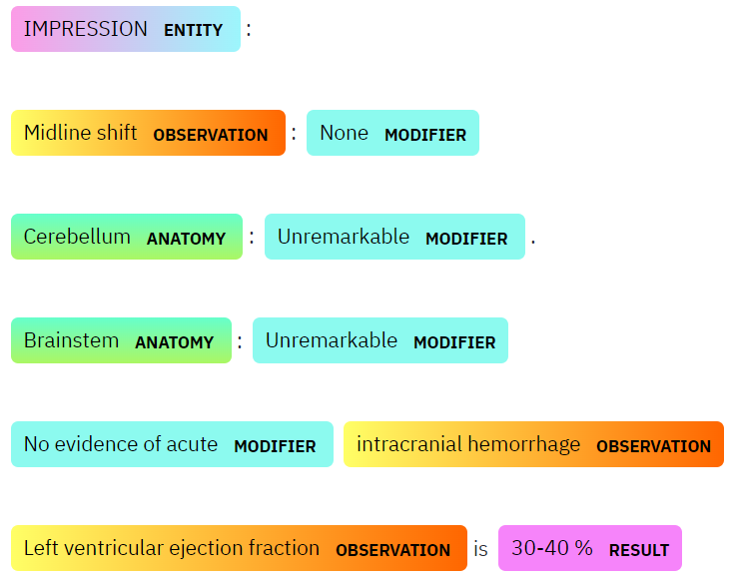
RelEx
Is-Result
Is-Result
Is-Result
Is-Result
Is-Result

Slide 41
Takeaways
Iteration speed is more valuable than you think
Sometimes ML/DL is not the answer…
Context, Context, Context!
Domain differences matter in NLP
Hacking on Spacy is not hard
Quality of Annotation is high priority
Source: Spacy IRL, accessed at https://www.youtube.com/watch?v=2_HSKDALwuw

Slide 42
Do not choose the best one choose the proper one
Notes:
© Copyright Showeet.com – Free PowerPoint Templates

Slide 43









Acknowledgement
Ines Montani
Matthew Honnibal
Sofie Van Landeghem
Vincent D. Warmerdam
Mark Neummann
Daniel King
Julien Chaumond
Thomas Wolf
Veysel Kocaman
And Many more…

Slide 44

Notes:
© Copyright Showeet.com – Free PowerPoint Templates

